Slide 1
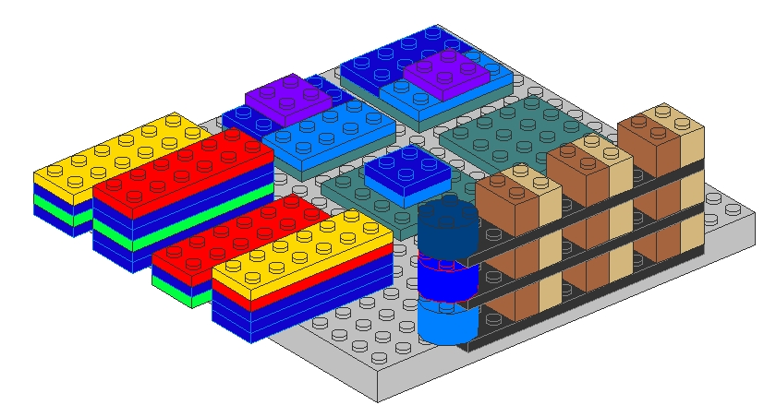
Functional Decomposition vs. Volatility-based Decomposition

Slide 2
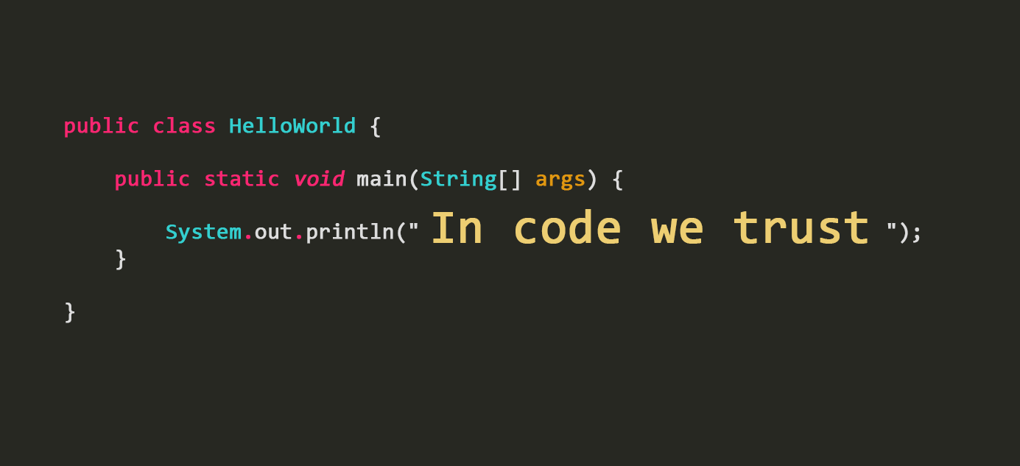
Coding Time

Slide 3

Thank you!

